Slide 1
Mole Station Activity
ACP Chemistry
Newton South High School

Slide 2
Directions
As you go through the power point presentation, answer the questions on each slide. As you perform your calculations, make sure you can find your answers (and units!) in the answer bank.
Please complete this assignment in your reading journal if possible.

Slide 3
Answer Bank
3.92 x 10²⁴
5.1 x 10²²
5.06 x 10²³
0.359
1.55 x 10²⁴
0.13
2.3 x 10²²
0.41
2.923
1.99 x 10²²
3.46 x 10²³
0.031
0.049
1.76 x 10²⁴
0.057
7.25 x 10²³
0.0845
0.0330
0.0016
9.0 x 10²²
5.06
5.09 x 10²²
9.07 x 10²³
mole(s) mole(s) mole(s) mole(s) mole(s) atoms
mole(s) mole(s) mole(s) mole(s) atoms atoms
molecules molecules molecules molecules atoms
formula units grams

Slide 4
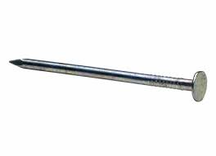
Station 1 – Iron Nail
Mass of this sample = 3.2 g
Iron is…
a) An element composed of atoms
b) An element composed of diatomic molecules
c) An ionic compound
d) Made from more than one type of atom
How many moles of iron are in the nail?

Slide 5
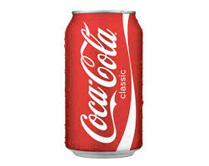
Station 2: Aluminum Can
Mass of this sample = 15.5 g
Aluminum is…
An element composed of atoms.
An element of diatomic molecules.
An ionic compound.
A covalent compound (composed of molecules made from more than one type of atom)
How many aluminum atoms are in the can?

Slide 6
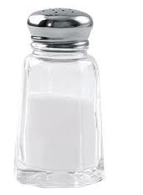
Station 3: Table Salt (sodium chloride)
Mass of this sample = 7.8 g
Sodium chloride is…
An element composed of atoms.
An element composed of diatomic molecules.
An ionic compound.
A covalent compound (composed of molecules made from more than one type of atom)
Write the chemical formula for sodium chloride.
How many moles of sodium chloride are in this sample?

Slide 7
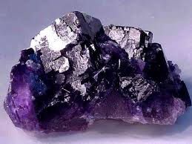
Station 4: Fluorite (Calcium Fluoride)
Mass of sample = 228.2 g
Calcium fluoride is…
An element composed of atoms.
An element composed of diatomic molecules.
An ionic compound.
A covalent compound (composed of molecules made from more than one type of atom)
Write the formula for calcium fluoride.
How many moles of calcium fluoride are in this sample?
How many calcium fluoride formula units are in this sample?

Slide 8
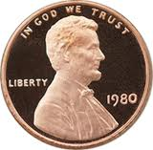
Station 5: Copper (pre-1982 penny)
Mass of this sample = 3.1 g
Copper is…
An element composed of atoms.
An element composed of diatomic molecules.
An ionic compound.
A covalent compound (composed of molecules made from more than one type of atom)
How many moles of copper are in this sample?

Slide 9
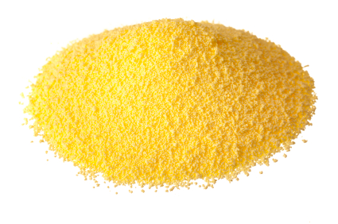
Station 6: Sulfur
Mass of this sample: 1.2 g
Sulfur is…
An element composed of atoms.
An element composed of diatomic molecules.
An ionic compound.
A covalent compound (composed of molecules made from more than one type of atom)
How many atoms of sulfur are in this sample?

Slide 10
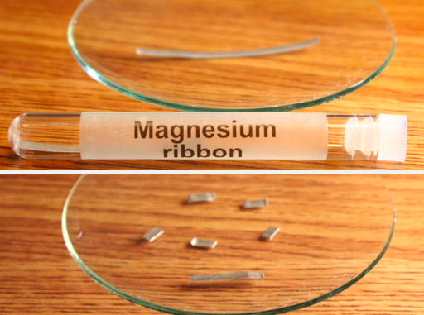
Station 7: Magnesium
Mass of sample = 0.039 g
Magnesium is…
An element composed of atoms.
An element composed of diatomic molecules.
An ionic compound.
A covalent compound (composed of molecules made from more than one type of atom)
How many moles of magnesium are in this sample?

Slide 11
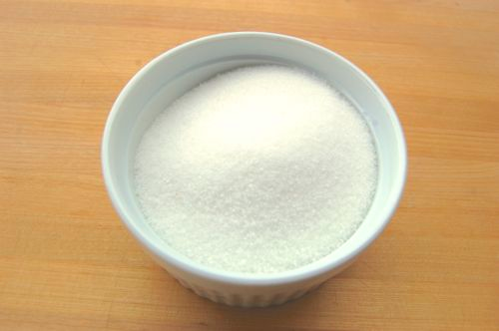
Station 8: Sugar (C₁₂H₂₂O₁₁)
Mass of this sample = 11.3 g
Sugar is…
An element composed of atoms.
An element composed of diatomic molecules.
An ionic compound.
A covalent compound (composed of molecules made from more than one type of atom)
How many moles of sugar are in this sample?
How many molecules of sugar are in this sample?

Slide 12
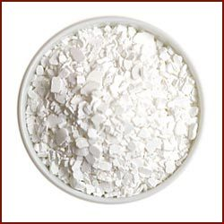
Station 9: Calcium chloride (road salt)
Mass of this sample = 3.4 g
Calcium chloride is…
An element composed of atoms.
An element composed of diatomic molecules.
An ionic compound.
A covalent compound (composed of molecules made from more than one type of atom)
Write the correct formula for calcium chloride.
How many moles of calcium chloride are in this sample?

Slide 13
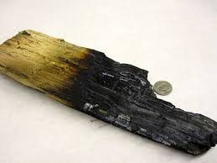
Station 10: Charred wood (carbon)
Mass of this sample = 18.1 g
Carbon is…
An element composed of atoms.
An element composed of diatomic molecules.
An ionic compound.
A covalent compound (composed of molecules made from more than one type of atom)
How many atoms of carbon are in this sample?

Slide 14
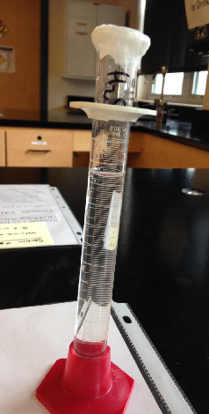
Station 11: Water
Volume of sample = 2.2 mL
Density of water = 1.00 g/mL
Water is…
An element composed of atoms.
An element composed of diatomic molecules.
An ionic compound.
A covalent compound (composed of molecules made from more than one type of atom)
How many water molecules are in the cylinder?

Slide 15
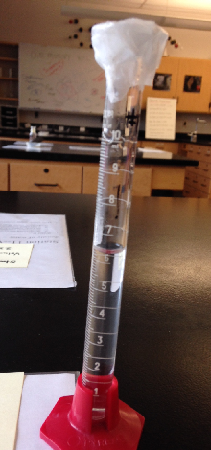
Station 12: Isopropyl Alcohol (rubbing alcohol)
Formula: CH₃CH(OH)CH₃
Volume of this sample = 6.2 mL
Density = 0.79 g/mL
Isopropyl alcohol is…
An element composed of atoms.
An element composed of diatomic molecules.
An ionic compound.
A covalent compound (composed of molecules made from more than one type of atom)
2) What is the mass of isopropyl alcohol in the cylinder? (Hint: use the density!)
3) How many molecules of isopropyl alcohol are in the cylinder?

Slide 16
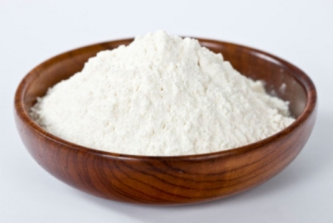
Station 13: Baking soda (sodium bicarbonate, NaHCO₃)
Mass of this sample = 30.2 g
Sodium bicarbonate is…
An element composed of atoms.
An element composed of diatomic molecules.
An ionic compound.
A covalent compound (composed of molecules made from more than one type of atom)
How many moles of sodium bicarbonate are in this sample?

Slide 17
Station 14: Wax (approximate formula C₂₅H₅₂)
Mass of this sample = 29.8 g
(assume the mass of the wick is negligible)
Wax is…
An element composed of atoms.
An element composed of diatomic molecules.
An ionic compound.
A covalent compound (composed of molecules made from more than one type of atom)
How many moles of wax are in the candle?
About how many molecules of wax are in the candle?
How many atoms are in this wax sample?

