Slide 1
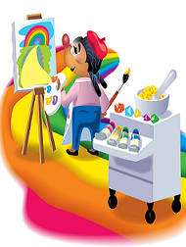
NCW 2015
Chemistry Colors Our World
Exploring the chemistry of dyes, pigments, and light
Newton South High School
October 18-24, 2015
Notes:
Background for the Presenter – This fall marks the celebration of National Chemistry Week (October 18-24, 2015). ACS members celebrate NCW by holding events in schools, shopping malls, science museums, libraries, and even at rodeos! Teachers and students often create their own NCW celebrations as part of their regular science studies. Each year National Chemistry Week chooses a theme for the celebration. The theme this year is “Chemistry Colors Our World”, Exploring the chemistry of Dyes, Pigments and Light.”
This PowerPoint presentation is designed for use by teachers or by chemists as a public outreach presentation. This presentation is a part of a set of materials from the American Chemical Society in support of National Chemistry Week. This set of slides presents some of the basic definitions and concepts dealing with color and color chemistry.
This presentation consists of text and images designed to illustrate basic science concepts in the context of color. You are encouraged to edit and alter this presentation to make it appropriate for various groups or to fit in with existing lesson plans.
The notes that accompany each slide suggest comments and additional explanations you might choose to share, cued by the text on each slide.

Slide 2

What is color and what does it have to do with chemistry?
Notes:
This slide can serve as an opportunity to set some basic definitions and lay out the connection between color and chemistry. Students may have misconceptions about the study of chemistry and think it only has to do with ‘blowing things up” or that chemicals are only the bad things that poison, as opposed to “natural” or “chemical free” substances.
All students will have an operational definition of color, but may not be able to put it in formal terms. These points need not be belabored, and it would be good to get to the next slide after a short introduction.

Slide 3
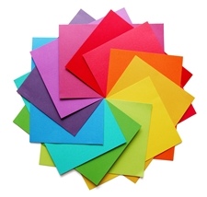
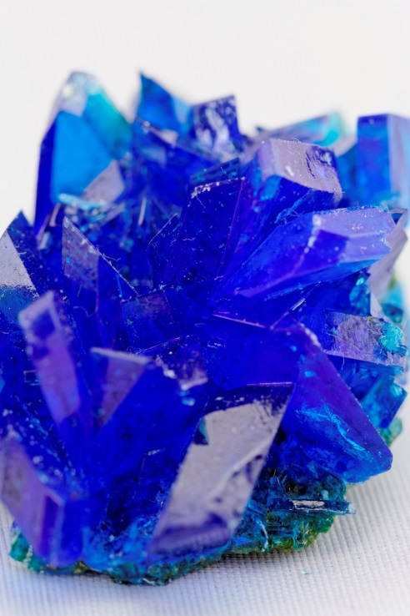
Color: How an object looks to our eyes, based on how it reflects or gives off light.
Chemistry: The study of the properties of matter and the changes that can occur in matter.
Copper II Sulfate
Notes:
A key point here is that color depends on light. It is likely that students will not have this concept as part of their operational definition of color. A large part of our understanding of color is based on our understanding of light.

Slide 4
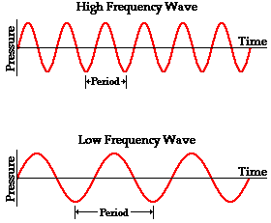
What is Light?
Light is a form of energy.
It travels through space like a wave.
Light is described by its Wavelength and Frequency.
Short wavelength
Long wavelength
Notes:
Explain frequency and wavelength. Light is most commonly described by these two measures. It should be easy for students to identify these two characteristics and you can point out they are interrelated. As the waves get more frequent, they get closer together. Use a comparison to the waves on a pond. When a stone is thrown into calm water it makes waves that spread over the surface. In water it would be easy to count the number of waves that pass by a point and to measure the distance between their crests. With light it is more difficult and we must rely on instruments to measure the wavelength and frequency. The wavelength of light is very small, only a few hundred nanometers (10⁻⁹ meters) and frequency in the hundreds of terahertz (10¹² cycles per second).

Slide 5
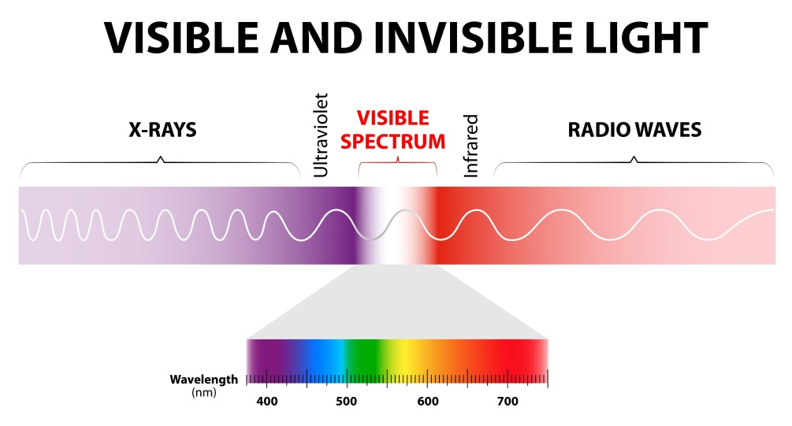
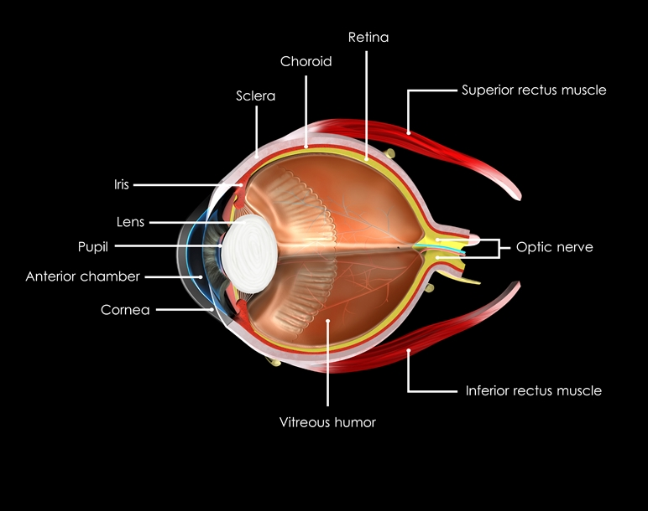
Our eyes can only see certain light wavelengths.
“Cone” cells in the back of the eye come in three types, ones that sense red, blue or green. These are called primary colors and the other colors we perceive are mixes of these primary colors.
Notes:
Visible light is only a small part of the electromagnetic spectrum, and it is the only part of the spectrum our eyes can detect. We can perceive infrared radiation as heat and our skin is sensitive to ultraviolet wavelengths. The world would look much different to us if we had more (or fewer) types of receptors. Other animals have different kinds of vision. For example, birds have four types of cones and can see ultraviolet. Dogs have only two types of cones and cannot see green.
Some people are color blind, which means they may not be able to detect one or more of the primary colors of light. This is due to a sex-linked trait that is inherited.

Slide 6
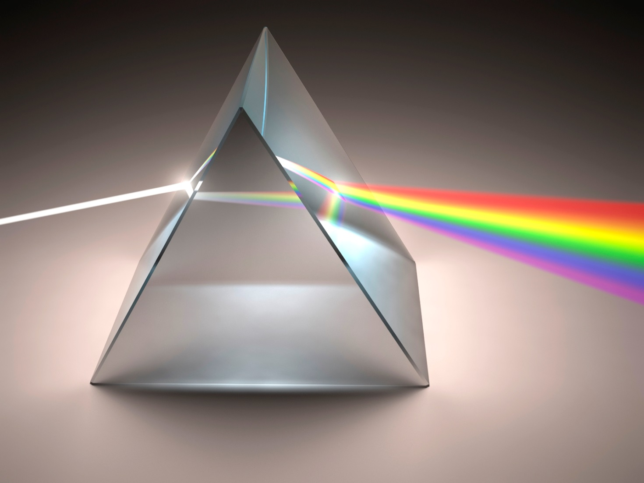
White light is made from all the colors of light.
Notes:
A glass prism reveals the make-up of white light by separating it into the component colors. Another prism can be used to recombine the colors into white light. Prisms work by refracting (bending) the various colors of light at different angles, based on their energy.
Isaac Newton used prisms such as this one to make many groundbreaking discoveries about the nature of light and color.

Slide 7
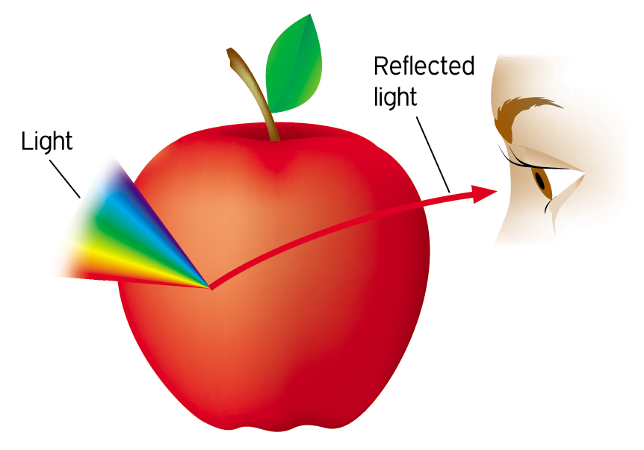
What gives objects their color?
Objects appear colored when they absorb some colors and reflect others.
Notes:
This graphic explains the main concept of how color works. As light strikes an object, some of the colors are absorbed and others are reflected. Our eyes see the reflected light and interpret it as color. This means that the kind of light we see depends on the kind of light that strikes the object. If we shine a blue light on a red apple it just makes the apple look dark, because there is no red light to reflect.
There is another class of color that we see that is not shown here. Sometimes objects emit light, such as heated metal, fireworks, light bulbs and so on. In that case the color is determined by the amount of energy involved in the release of the photons of light.

Slide 8
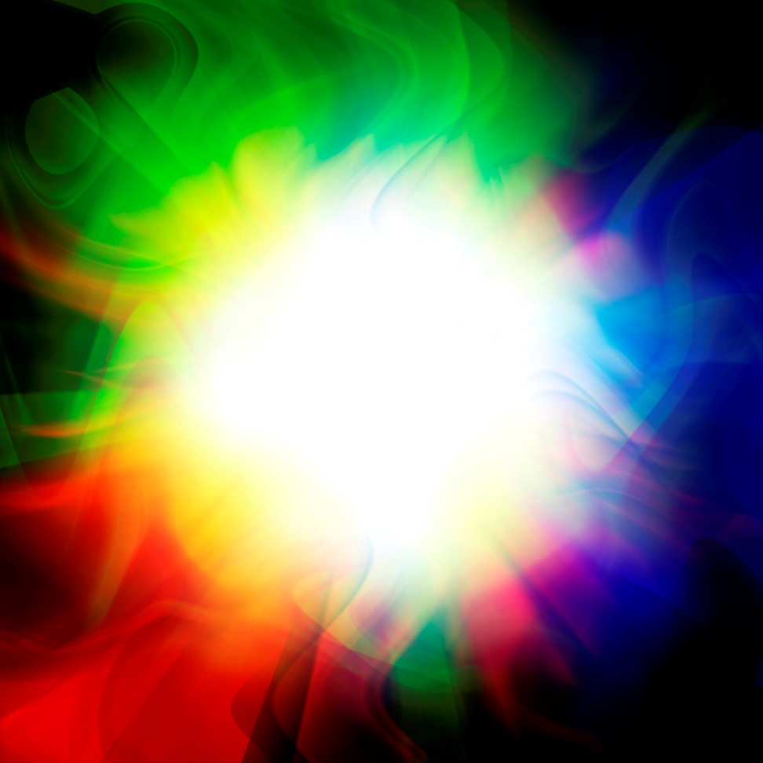
Adding blue, green and red light in equal amounts produces white light.
Mixing light is called additive mixing.
Adding them in unequal amounts leads to all the other possible colors. For example, adding red to green gives yellow light.
Source: U.S. Department of Commerce
Notes:
When our eyes are stimulated by both red and green light, our brain interprets the melded signals as yellow. By the same mechanism, when blue, green and red light stimulates all three kinds of cones at the same time, our brain processes this as white light. To a great extent, color only exists in our brain!

Slide 9

Mixing pigments is called subtractive mixing.
Pigments are molecules that absorb (or subtract) certain colors of light and reflect others.
Yellow pigment absorbs blue and reflects green and red, which mix and we see as yellow.
Notes:
The color of objects is based on their chemical structure and the coloring agents they contain called pigments. Pigments selectively attract or reflect the various parts of the visible spectrum. Any light that is absorbed is ‘subtracted’ from the mix and what we see is the result.

Slide 10
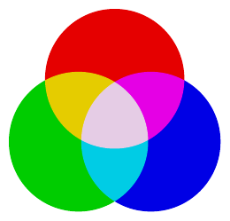
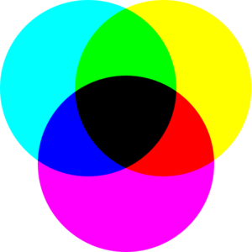
Mixing Light vs. Pigments
Light
Primary Colors Red, Blue & Green
Red+Green = Yellow
Red+Blue = Magenta
Green+Blue = Cyan
Red+Green+Blue = White
Primary Colors Magenta, Yellow & Cyan
Cyan+Yellow = Green
Cyan+Magenta = Blue
Yellow+Magenta = Red
Cyan+Yellow+Magenta = Black
Pigments
Notes:
This slide contains two animations that will begin to play automatically, one after the other and continue to loop until the slide is changed. The top video shows how circles of light mix and blend into the various colors. The bottom video starts after one cycle of the top video plays.
Allow students some time to watch how the colors mix, and the differences between the two systems. Have students focus on the red and green colors of light and how they form yellow as they intersect. Then shift their attention to another combination. Play the videos until they get a solid idea how additive and subtractive mixing works.

Slide 11
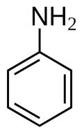
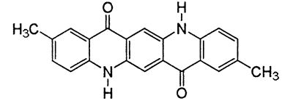
Question: Where do pigments and dyes come from?
Answer: From a wide ranges of chemical compounds.
Some pigments and dyes come from natural products such as marigold flowers or beets.
Many ores and minerals contain colored inorganic compounds such as cinnabar (HgS) and azurite (2 CuCO3-Cu(OH)2).
Chemists have created many organic molecules that are very brightly colored, such as aniline and quinacridones.
Some examples of colors in man-made products and nature are shown in next slides.
Notes:
This chemistry gets complex very quickly, but don’t let the chemical structures overly complicate the explanation of how pigments work. The basic message is that there are many colored substances that can be used as pigments or dyes based on their fundamental chemical structure. If you have an advanced audience you could go so far as to talk about how the arrangement of the atoms and their bonds affects the way photons are absorbed by electrons in the bonds. If visible light falls on a section of a molecule and electrons absorb the energy, they can be elevated to an excited state. The remaining light is not absorbed and is reflected, leading to the perceived color of the pigment.
The next few slides have some examples of some of the specific chemical compounds that are involved in paints, fall colors and fireworks. You may have other examples that you would like to share or present.

Slide 12
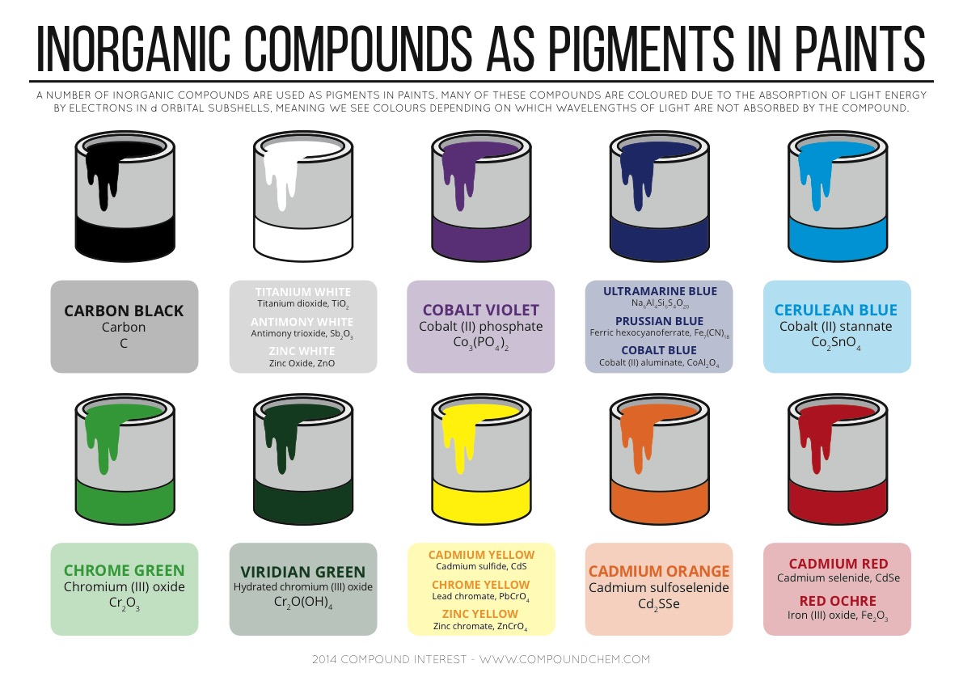
Chemistry of Some Pigments
Copyright 2015 Andy Brunning/Compound Interest.
Notes:
Once again, this slide may be too complicated for a young audience, but you could focus on a couple of simple examples if that is the case. For example, carbon black is just soot or charcoal, which most kids should be familiar with. The carbon is made into paint by adding a binder which supports the color in a homogenous mixture and helps the color adhere to the painted surface after drying. Refer to the article on Natural Dyes and Pigments by V.M. Norwood in the 2015 edition of Celebrating Chemistry.

Slide 13
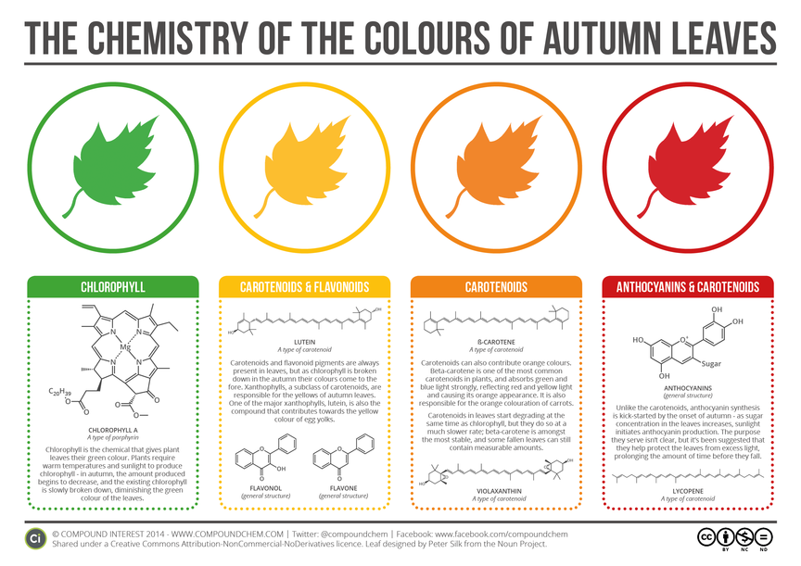
Notes:
These examples come from nature, and students will likely be familiar with the fall colors that appear in trees and shrubs. Again, the chemistry is complex, but the basic lesson is that certain molecules in the plant are responsible for the various colors. Different chemical structures give different colors.

Slide 14
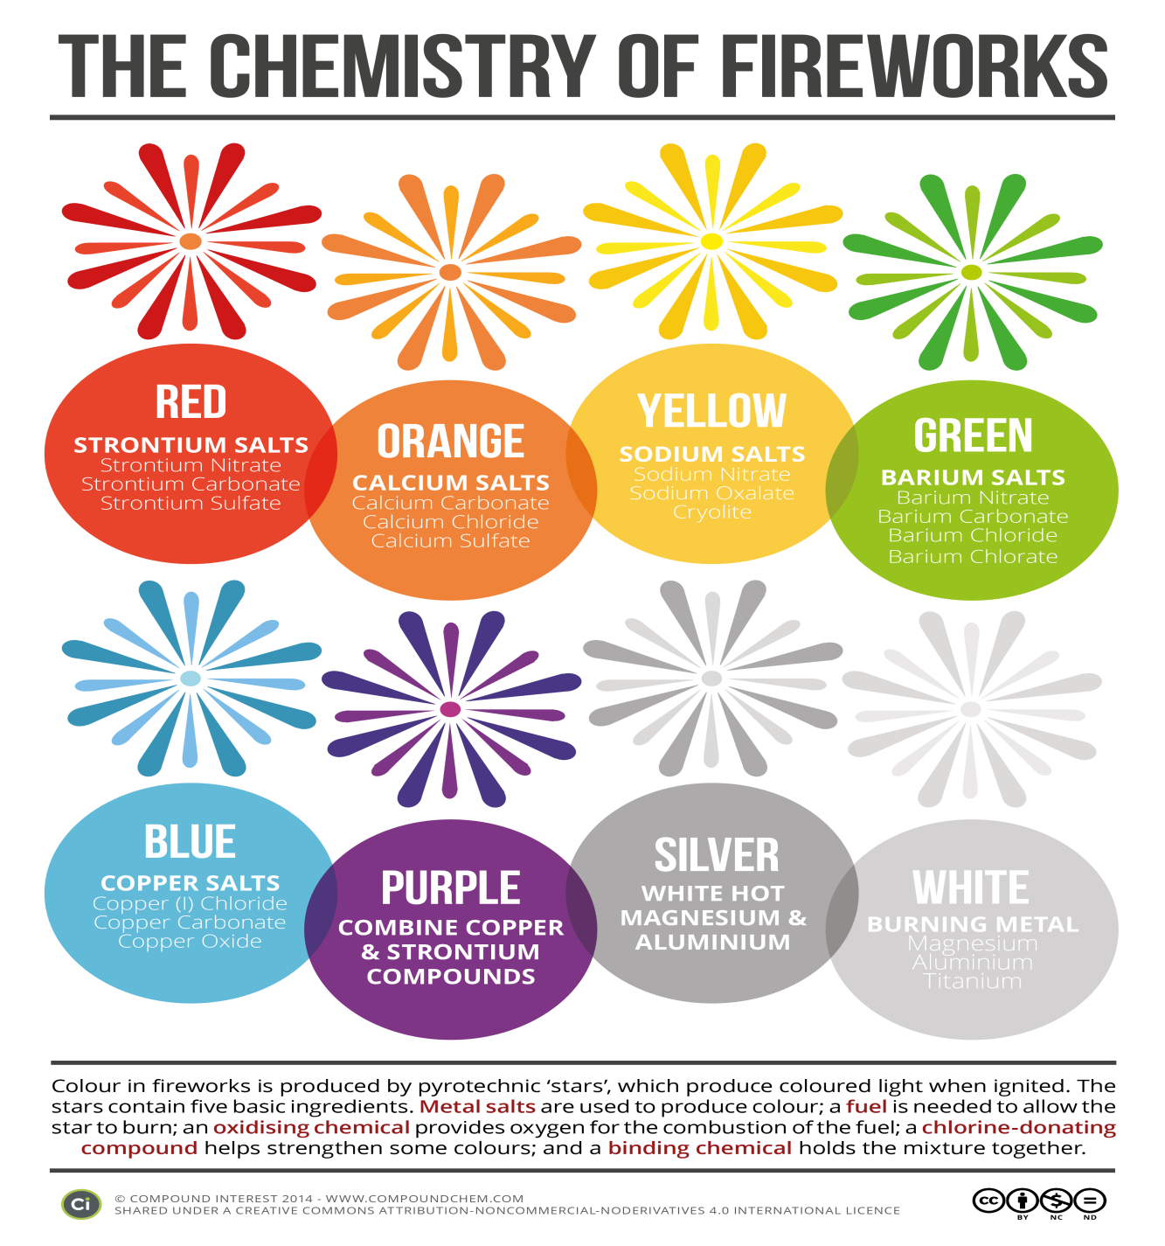
Notes:
This is a different type of example of color, but still a familiar case for most students. In this case it is not a matter of pigments, but of light that is emitted from excited atoms, mostly from transition metals. There is an excellent article on fireworks by Al Hazari in the the 2015 edition of Celebrating Chemistry that provides more information on how fireworks work.

Slide 15
References:
Celebrating Chemistry, NCW 2015 edition: ”Chemistry Colors Our World,” American Chemical Society, Washington D.C.
Compound Interest, Chemistry based infographics from UK Chemistry Teacher Andy Brunning, free for educational uses. http://www.compoundchem.com/. Copyright 2015 Andy Brunning/Compound Interest.
Orna, Mary Virginia,The Chemical History of Color, Springer SBM: Heidelberg, 2013,153 pp. ISBN 978-3642-326417.

